Slide 1
《英语国家社会与文化入门》(上册）
The Society and Culture
of Major English-Speaking Countries
An Introduction
(Book One)

Slide 2
Australia Unit 16 Australian Cultural Life

Slide 3
Quiz
Give the English and a brief explanation for the following:
1. 多元文化的
2. 救世军
3. 现世主义的
4. 帕特里克﹒怀特
5. 《辛德勒的名单》

Slide 4
Focal Points
Protestantism
the Dreaming
Fundamentalism
non-Christian religions
sport as a Secularist religion
Modern Australian literature
Patrick White
Australian films

Slide 5
This Unit Is Divided into Four Sections
Religion
Sport -- a Secularist Australian Religion?
Australian Literature
Films

Slide 6
I. Religion
Protestantism and the Dreaming
There is a major contrast between the Dreaming and Protestantism.
The Dreaming means that people do not own the land, but the land owns the people who have responsibilities of guardianship towards it.
After 1788, Protestantism became the dominant form of religion, and a central concept of Protestantism is that individual people own, and are obliged to use and exploit the land for the greater glory of their God.

Slide 7
I. Religion
The British brought their form of Protestantism, Anglicanism, to its new colony, and this religious culture supported the values of the new Australian ruling class, the Military and Government leaders, the business owners and large scale agriculturalists of the 19th century. (Right: St John Baptist Church built in 1840s)

Slide 8
I. Religion
Protestantism spread the idea that the people at the top of society, the wealthy and the powerful were successful because they were the ones doing God’s will. The majority of people in this new colony -- the convicts and the poorer free men and women were seen as being, not only lower in the social scale, but lower in the eyes of God. (Right: Convicts)

Slide 9
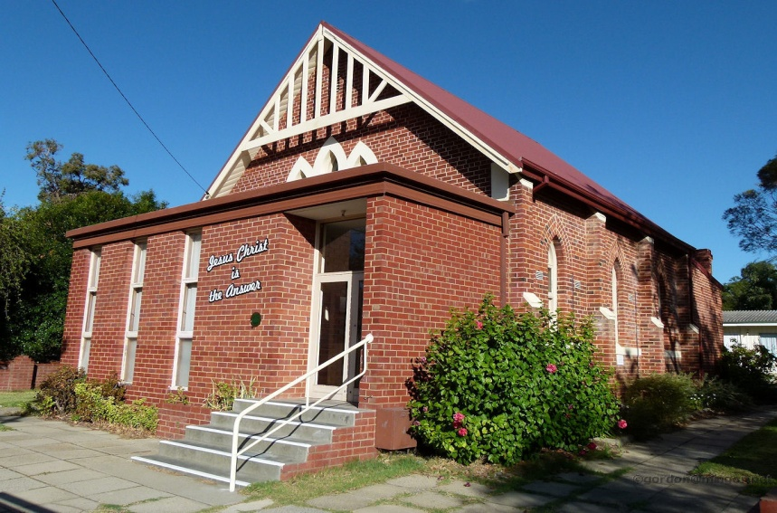
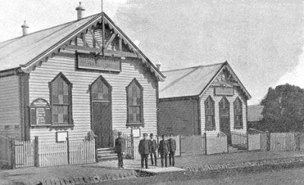
I. Religion
By the 1850s these social class differences had led to different versions of Protestantism, with the upper and middle classes remaining with Anglicanism, whilst Congregationalism, Methodism and the Salvation Army gave greater emphasis to the view that “we are all equal before God” which appealed more to working class communities or to those in the middle class who preferred this more egalitarian approach to society.
(Right: Salvation Army in early days; left: a Congregational Church)

Slide 10
I. Religion
Catholicism
In the latter half of the 19th century it was the Catholics, most notably the Irish political convicts and refugees from famine, who played a significant part in the establishment of the alternative working class culture.
Catholics, working class Protestants
and Secularists combined to
establish unionism and to create
the political party that represented
labour—the Australian Labor Party
(the ALP).

Slide 11
I. Religion
The Non-Christian Religions-- Buddhism, Islam, Hinduism and Judaism:
The histories of Buddhism, Islam and Hinduism in Australia have similar patterns: a modest mid-19th century growth; a cut back at the beginning of the 20th century due to the racist White Australian Policy, and a significant proportional increase when Australia became a multi-cultural society in the 1970s. Buddhism is now the fastest growing belief system in Australia.

Slide 12
I. Religion
Fundamentalism and Evangelicalism
Fundamentalism is often a feature of a society in a rapid state of change. When cultural values seem to be shifting too quickly a form of cultural anxiety can occur. For some people there is a need to reaffirm the values of one’s earlier life. Fundamentalism is not confined to any one religious belief. In Australia, there are fundamentalist forms of Protestantism, Catholicism, Islam, and Judaism. Fundamentalists want to maintain or to recreate what was (or what was thought to have been) the fundamental values of an earlier culture.

Slide 13
I. Religion
Securalism is the rejection of any religious belief. Secularists use non-religious values to guide their lives. As only 13% of the population attends church each week, Australia could be described as a secular society. However, many non-churchgoers stay committed to a form of belief. At key points of change in peoples’ lives—at death, birth, marriage or when going to war, the church becomes an important institution.

Slide 14
II. Sport -- a Secularist Australian Religion?
Sport has shaped the Australian national identity.
Sport in Australia is an important part of the country’s culture, dating back to the early colonial period.
The principal game in Australia is football .Other sports played in Australia include cricket, hockey, basketball, beach volleyball, swimming, netball, horse racing, car racing.
The media plays an important part in Australia's sporting landscape, with many sporting events televised or covered on radio.

Slide 15
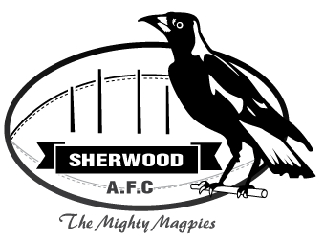
II. Sport -- a Secularist Australian Religion?
Many features of sport in Australia seem to reflect the patterns of religion. Ritually, every Saturday hundreds of thousands of Australians gather at sports fields and arenas in every city, dressed in their sports team’s special colours. Many carry emblems representing the team’s symbolic creatures—the Magpies, the Bulls, the Roosters, etc. The fans enter the arena, and chant their team’s special songs.

Slide 16
II. Sport -- a Secularist Australian Religion?
Football in Australia– Australian Rugby League (ARL), Australian Football League (AFL), and Australian Rugby Union (ARU).

Slide 17
II. Sport -- a Secularist Australian Religion?
In Australia today sport plays a dominant role and affects the broader culture. Some sociologists point out that Australians spend far more, per capita, on the training of elite athletes than they do on the training of doctors, scientists, musicians and philosophers. Australia so glorifies competitive sport it is as if sport is now the basis of the country’s values and priorities. Some are concerned about the excessive masculinism of Australian sport, exemplified by the 98:2 ratio of male: female sport coverage on television.

Slide 18
II. Sport -- a Secularist Australian Religion?
Sport also has positive characteristics. It creates a sense of community, potentially balances the spirit of competition within the broader culture of fair play, and encourages exercise and physical fitness. Moreover, there are forms of sport which are neither overly competitive, nor gender biased.
The beach is one of the most popular places for these activities. Australians love body surfing, sea swimming, board surfing, picnicking, beach cricket, or building sand castles, all just for the fun of it.

Slide 20
III. Australian Literature
The history of Australian literature covers an immense field, from the Dreamtime stories, myths and legends that have been passed on orally or visually by artistic representations on rocks and on bark over 40, 000 years, through to the various forms of Australian literature in the English language which covers the period 1788 to the present day.
Australian literature includes not only fiction, verse, drama, history, biography and autobiography, but also journals, diaries, letters and memoirs.

Slide 21
III. Australian Literature
The journals of Captain Cook and Sir Joseph Banks give detailed insights into how the English explorers and settlers interpreted the Peoples, the country and their own experiences of the Australian continent. These early writings from Australia were written in the English style for an English audience.
During the next few decades Australian writers began to write from a more Australian perspective focusing on constructing this new Australian identity as convicts, bushrangers, and pioneering bush families. Writings of the “romance of the Bush” creating stereotypes that appealed to Australians’ wish to see themselves as a tough, hardy, egalitarian set of characters, different from “people back Home”.

Slide 22
III. Australian Literature
This poem by Paterson tells the story of a horseback pursuit to recapture a prizewinning racehorse that escaped.
This novel by Marcus Clarke is the best known novel of life as a convict in early Australian history.

Slide 23
III. Australian Literature
“Realism” defined the early 20th century literature. The increasing industrialization of the early 20th century meant a move away from the rural bases of the earlier Australian literature. Urban Australian life was represented by both the Romantics and the Realists.
In the 1950s and 1960s many Australian writers were aware that to gain a name they had to leave Australia. Most went overseas to Europe.
In the late 1960s and 1970s, Australians developed a different, broader sense of self identity, less deferential to the British culture and greater self confidence in being Australian, especially in being Australian in the Asia Pacific region.

Slide 24
III. Australian Literature
By 1973, the dominating figure in Australian literature, Patrick White (1912-90), The Aunt‘s Story (1948), The Tree of Man (1955), Voss (1957), The Solid Mandela (1966), earned world status as a novelist when he was awarded the Nobel Prize for Literature. Patrick White.

Slide 25
III. Australian Literature
Ruth Park, a New Zealand-born Australia writer, also won many literary awards for works including the trilogy of The Harp in the South (1948), Poor Man's Orange and Missus (1949) and the children’s book the Muddle Headed Wombats series (1962-1982). Her work was translated into 37 languages. (Left: Ruth Park in 1951)

Slide 26
III. Australian Literature
In the 1990s, this variety of ways of “being Australian” was further broadened when the voices of second generation migrants were published in novels, journals, essays, and poetry.
Melina Marchetta’s novel, Looking for Alibrandi, through her own experiences, tells the story of the relationships between three generations of Italian Australian. This theme, not simply of the issues and complexities of multiculturalism, but of the insights this brings to our humanity in general, similarly underpins Christos Tsiolkas’ novels.

Slide 27
III. Australian Literature
Alice Pung’s book, Unpolished Gem, based on her family’s migration from China to Australia, became a national bestseller winning the Australian Book Industry Newcomer Award, 2009 for her portrayal of what it is like to be caught between two cultures.

Slide 28
III. Australian Literature
Nam Le is a Vietnamese –born Australian writer. His collection of short stories, The Boat, was the winner of the 2009 NSW Premiers Literary Awards Book of the Year. Nam Le was able to engage the reader in a range of experiences across the world, from Tehran, the slums of Columbia; to the USA and Australia.

Slide 29
III. Australian Literature
There is a strong link in Australia between literature and film. For the Term of His Natural Life, The Man from Snowy River, My Brilliant Career, Picnic at Hanging Rock and The Sentimental Bloke are just five films based on the earlier Australian novels. There are too many recent novels that have been translated into films to list here.
Picnic at Hanging Rock

Slide 30
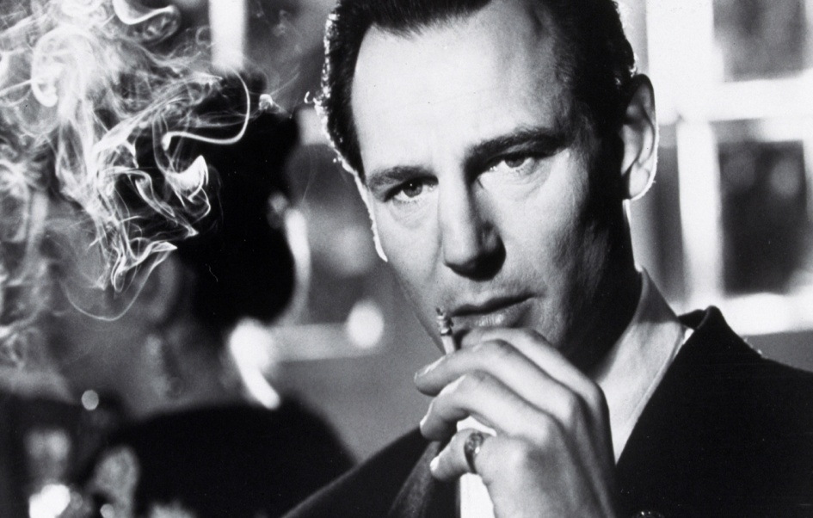
III. Australian Literature
Probably the most influential film based on a novel by an Australian author has been Spielberg’s film of Thomas Keneally’s Schindler's Ark, renamed as Schindler’s List.

Slide 31
IV. Films
Although many other forms of entertainment today compete with films, “going to the pictures” is still one of the most popular forms of entertainment in Australia.
In the 1920s and 1930s, it became much cheaper for Australian film and TV distributors to buy ready made overseas films and TV programmes from the UK and from Hollywood.
The Australian government intervened in the 1970 and 1980s by providing funding bodies both for the production of films and in the training of film makers.
This led to a revival of the film industry creating “the New Wave” lasting from 1970 to 1985 when Australia produced nearly 400 films.

Slide 32
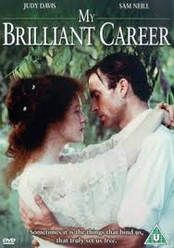
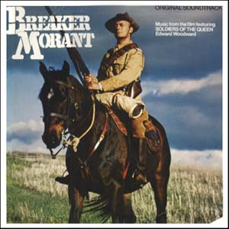
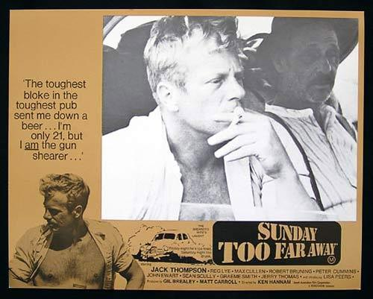
IV. Films
In this era, Australian film directors Gillian Armstrong, Peter Weir, Phil Noyce and Bruce Beresford and actors Judy Davis, Sam Neill, Mel Gibson, Jack Thompson flourished, producing films with strong Australian themes: Sunday Too Far Away, Caddie, The Devil's Playground, Don's Party, My Brilliant Career, Mad Max: the Road Warrior, Gallipoli, and Breaker Morant.

Slide 33
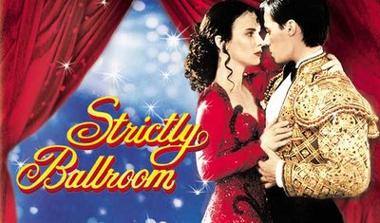
IV. Films
A new wave of Australian directors produced internationally successful films like the Academy Award winning Shine and films reflecting contemporary Australian values about comedy, romance and sexuality Crocodile Dundee, Strictly Ballroom, Muriel’s Wedding, and Priscilla, Queen of the Desert.

Slide 34
IV. Films
The three films here have all been created and driven by the experiences of the Peoples of the Dreaming and their descendants: The Rabbit Proof Fence, Ten Canoes and Samson and Delilah.
Although these stories have always underpinned Australian history, they have rarely before been a significant part of the way the majority of Australians see and define themselves through film. This is an important stage in Australian culture because for the first time it is the indigenous peoples of Australia who are in charge of constructing the stories and the values underpinning those stories of the films that people watch.

Slide 35
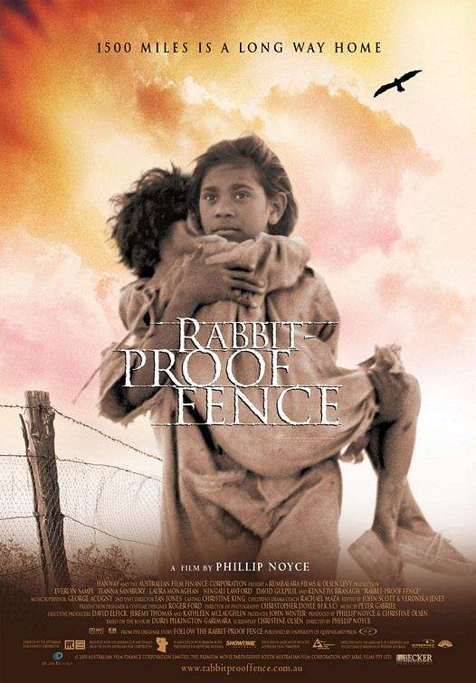
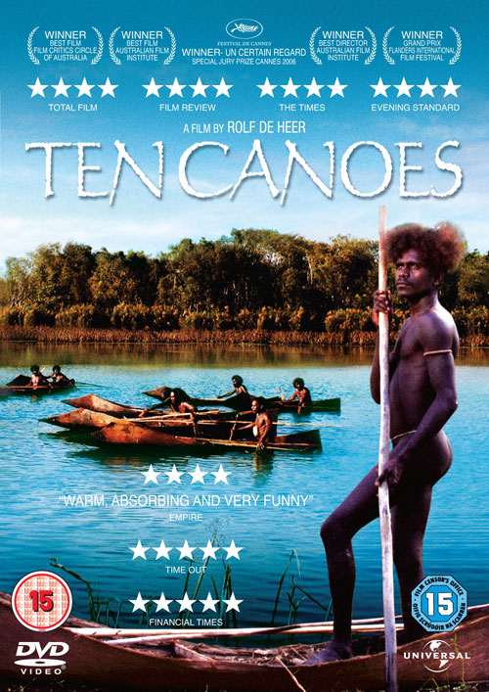
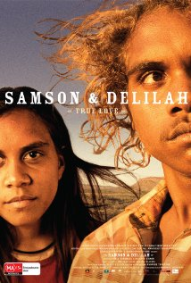

Slide 36
Questions for Discussion
A. What is Fundamentalism? How is it related with social change?
B. Why does the author consider sport as a secularist Australian religion?
C. How has Australian literature evolved over the past decades? Illustrate your point with examples.
D. What is Australian self identity expressed through literature?
E. What is the relationship between literature and films in Australia?

Slide 37
The End
高等教育出版社
2015

